Slide 1
GRAPH
MATH

Slide 2


Gastiadirijal Naufaldy Kestiyanto
Maula Balqis Ansya Aulia
17 / 2241720246
11/ 2241720001

Slide 3
CONTENTS
01
03
Definition of each graphs
Usage of each graphs
02
04
Function of each graphs
Illustration of each graphs

Slide 4
What is the function of using graphs?
Graphs serve to assist the presentation of data so that it is easily understood by the reader. In addition to graphs, data is usually presented in tabular form, but data presented in tabular form is considered less attractive.
Definition
Graphs are a form of visual communication where a simple dot or stroke can communicate a message to others. In the world of education, graphs can be used to convey messages or information that is educational.

Slide 5
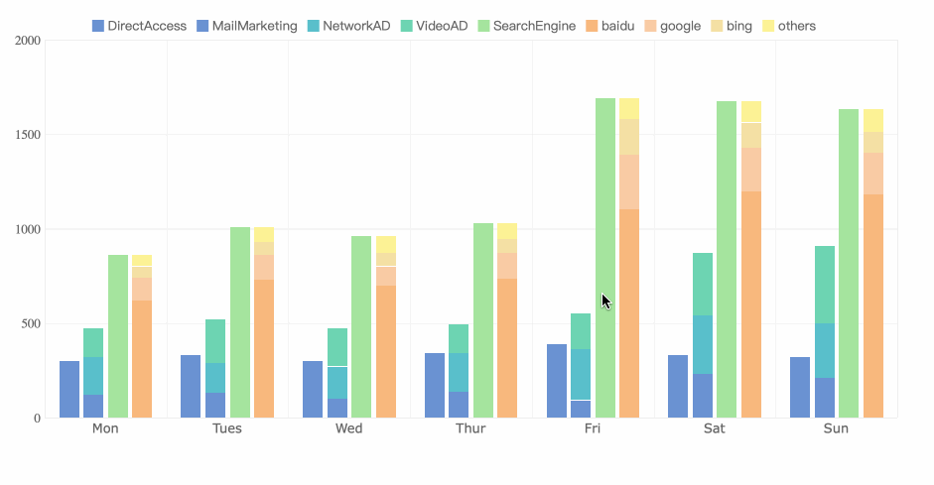
Bar Graph
A bar graph is a graphical representation of information. It uses bars that extend to different heights to depict value and it uses vertical bars to show numerical comparisons between categories. The bar graph has the advantage that it uses the height of the bars to capitalize differences in the data because the human eye is very sensitive to height differences.

Slide 6
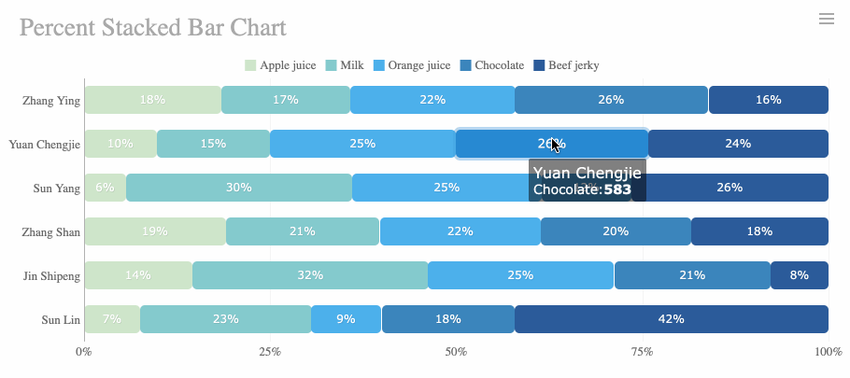
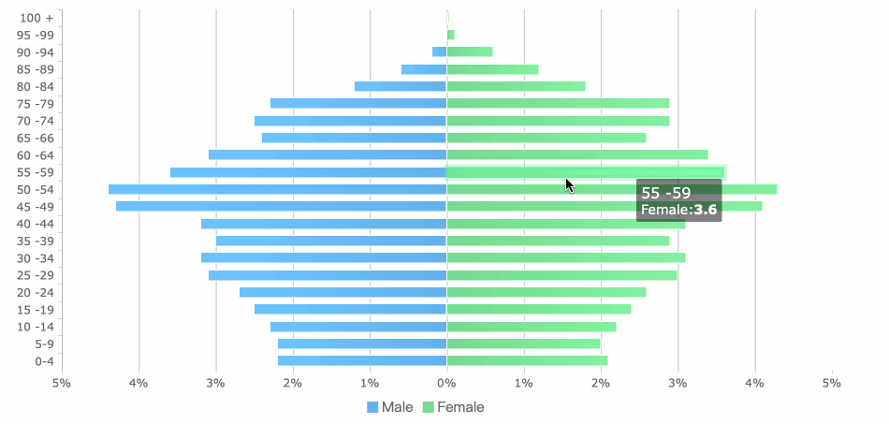
Beam Graph
A beam graph almost acts the same as a bar graph, but the output instead of projecting vertically, beam graph projects horizontally to display the information.
Usage example: data comparison (category names can be extended because there is a lot of space on the Y axis)

Slide 7
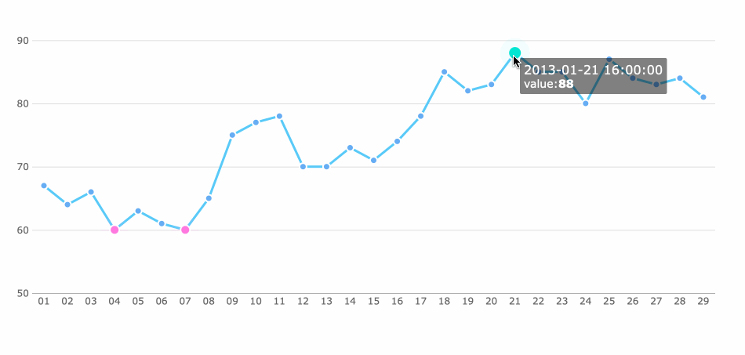
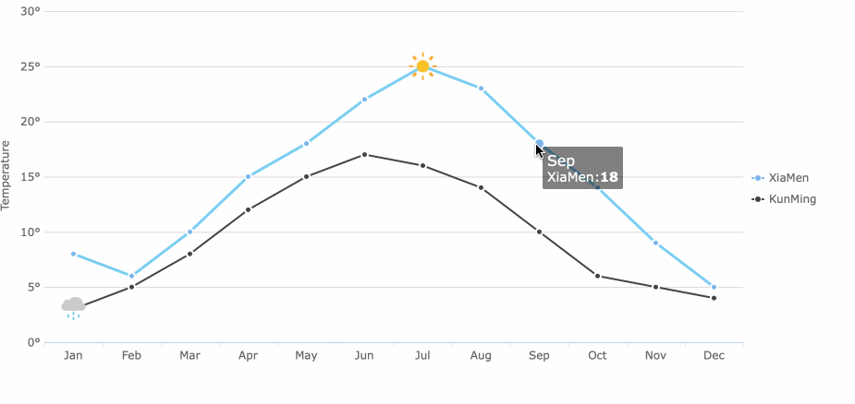
Line Graph
A line graph or line chart or line plot is a graph that utilizes points and lines to represent change over time. It is a chart that shows a line joining several points or a line that shows the relation between the points.
Usage example: Comparing multiple data in one time span)

Slide 8
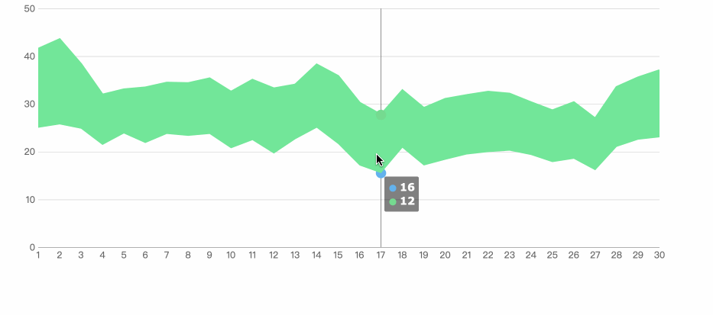
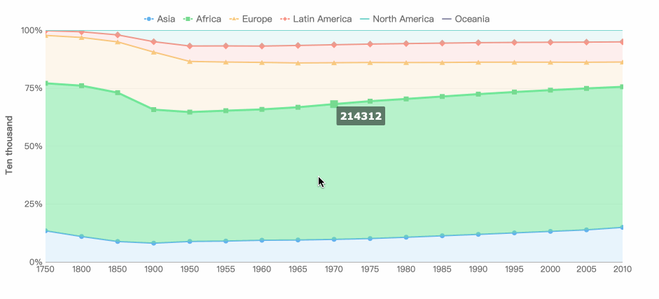
Area Graph
Area graphs are formed based on line graphs. It fills the area between the polyline and the axis in the line graph with color. Area graphs can be effective for showing the rise and fall of various data series over time.
Usage examples: ratio between series, time ratio.

Slide 9
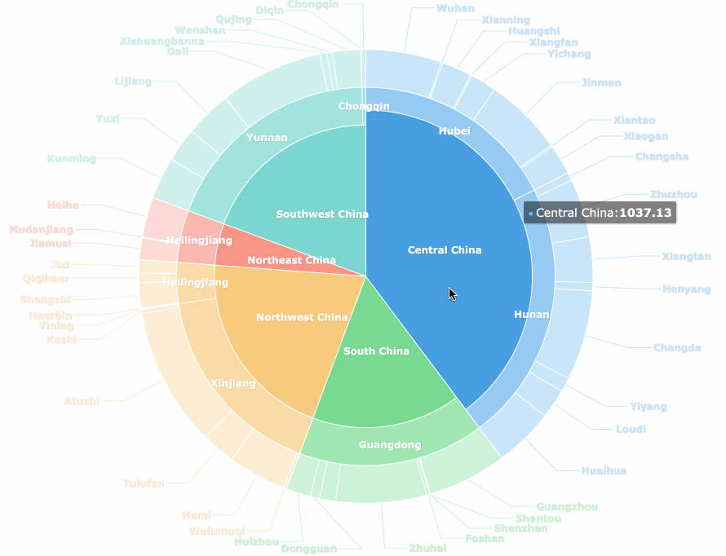
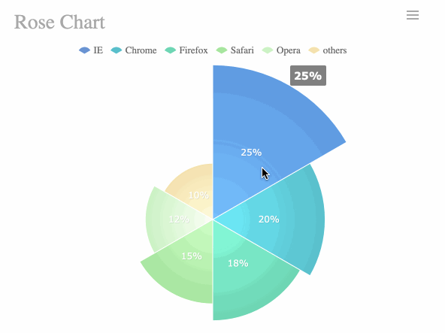
Pie Chart
Pie charts are widely used in various fields to present the proportion of different classifications and to compare different classifications based on their arcs. Pie charts can also be made into multi-layer pie charts that show the proportion of each classification and at the same time display the relationship between classifications.
Usage examples: ratio between classifications, size comparison (rose diagram)

Slide 10
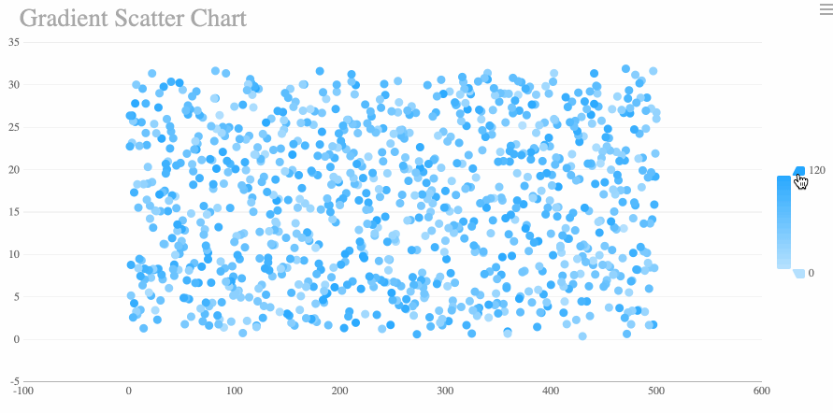
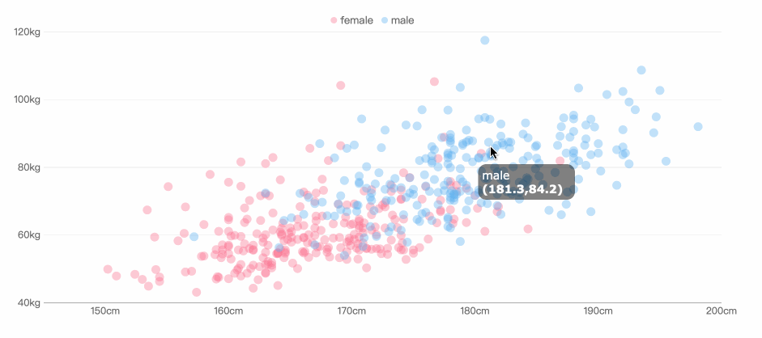
Scatter Plot
A scatter plot is a type of plot or mathematical diagram using Cartesian coordinates to display values for typically two variables for a set of data. If the points are coded, one additional variable can be displayed.
Usage examples: correlation analysis, data distribution

Slide 11
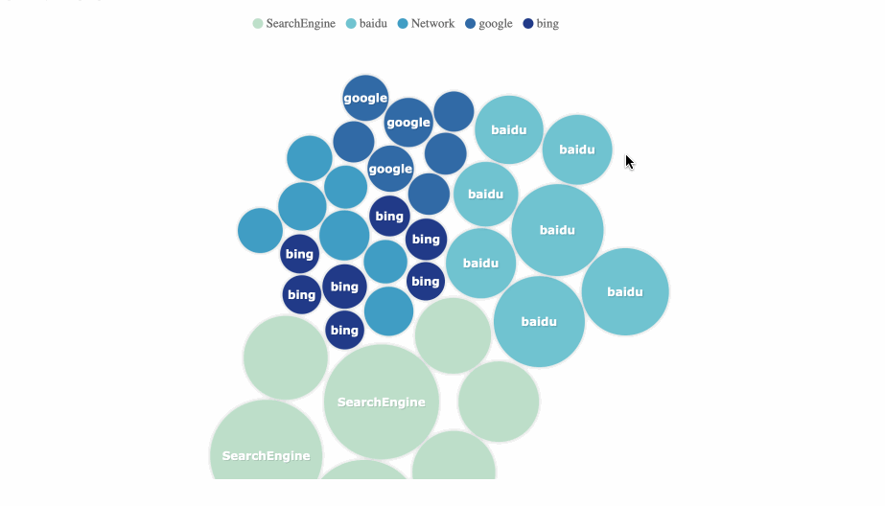
Bubble Chart
A bubble chart is a type of chart that displays three dimensions of data. Each entity with its triplet of associated data is plotted as a disk that expresses two of the values through the disk's x and y location and the third through its size.
Usage examples: comparison of classified data, correlation analysis

Slide 12
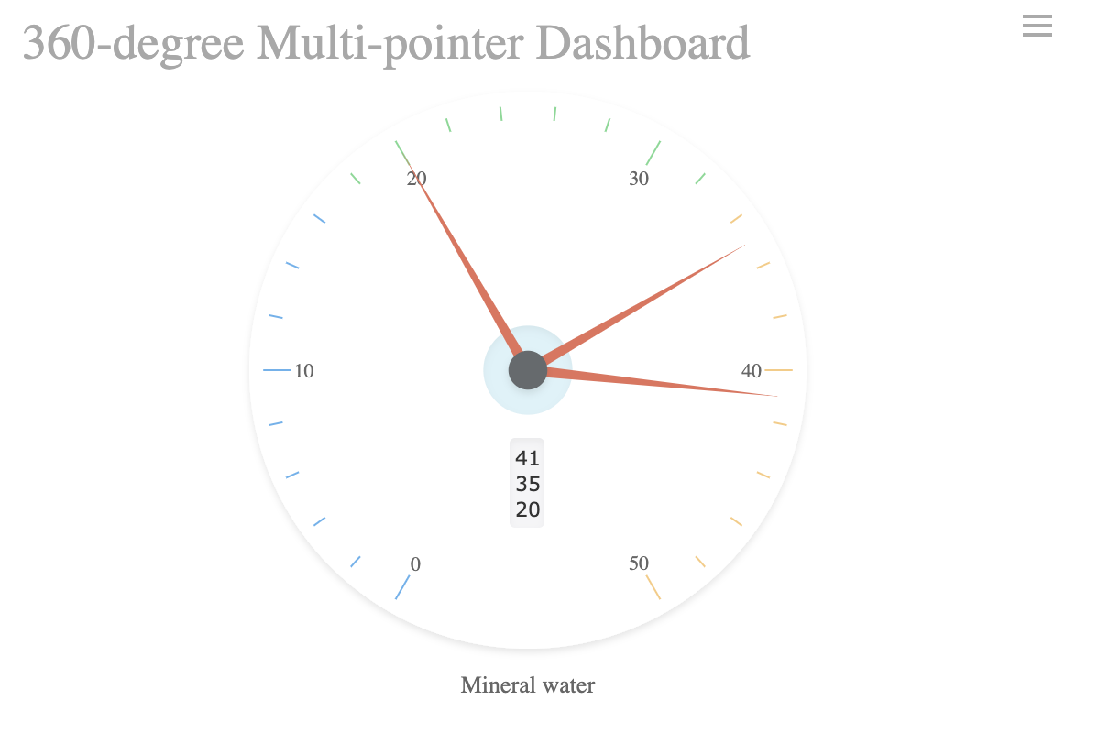
Gauge
A gauge chart, also known as dial or speedometer chart, is a data visualization type used to display a single value of data in a quantitative way. By using a colored data range, gauge charts enable users to understand the progress of a KPI against a set target.
Usage examples: clock, ratio display

Slide 13
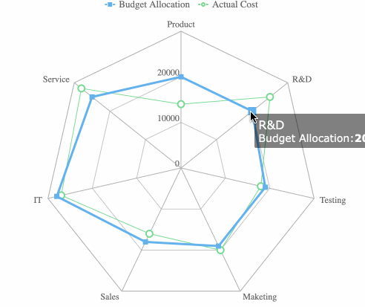
Radar Chart
A radar chart shows multivariate data of three or more quantitative variables mapped onto an axis. It looks like a spider's web, with a central axis that has at least three spokes, called radii, coming from it. On these spokes, the values for the data are mapped.
Usage examples: dimensional analysis, series comparison, weight analysis between series

Slide 14
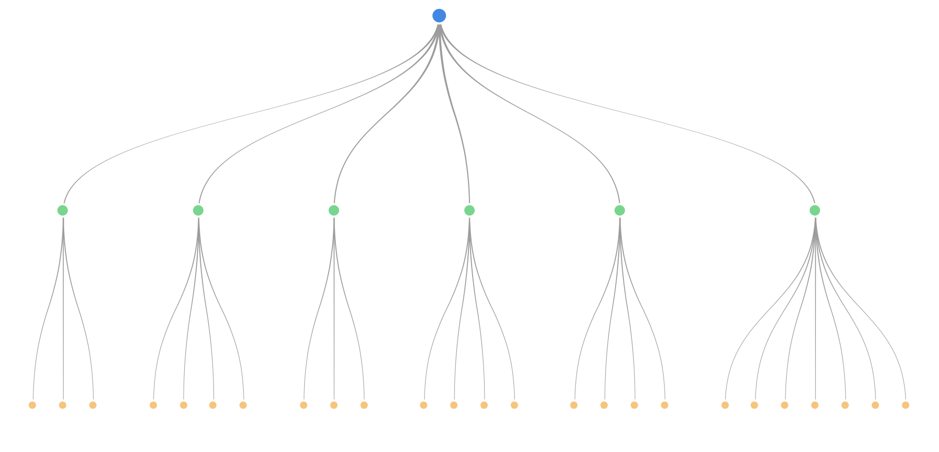
Frame Diagram
A frame diagram is a visual way of presenting a hierarchy or sequence in the form of a tree structure that clearly shows hierarchical relationships.
Usage examples: tree view, process view

Slide 15
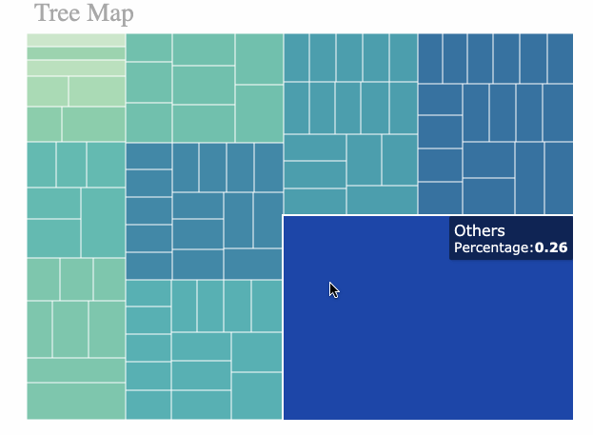
Square Tree Diagram
Square tree diagrams are suitable for displaying data with hierarchical relationships, which can visually reflect comparisons between the same levels. Compared to the traditional tree chart, the rectangular tree chart makes more efficient use of space which has the function of showing proportions.
Usage examples: weighted tree data, tree data proportion

Slide 16
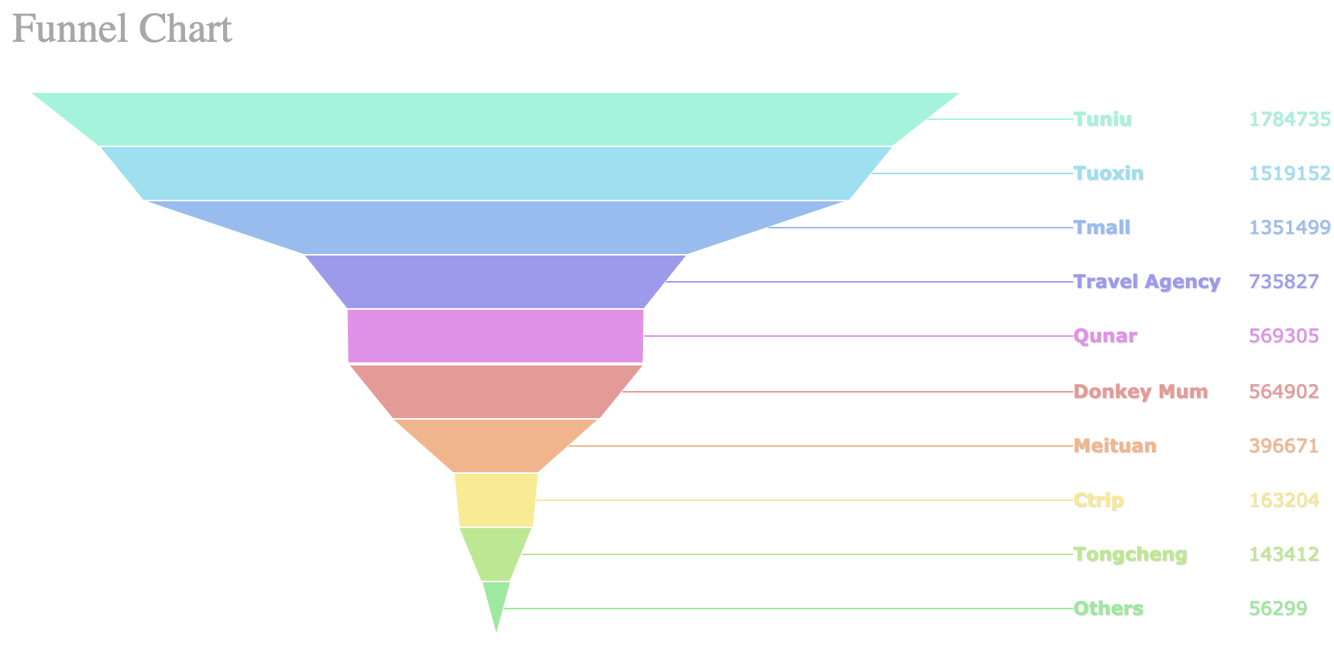
Funnel Chart
The funnel chart shows the proportions of each level and visually reflects the size of each module. This graph is suitable for comparing ratings. At the same time, funnel graphs can also be used for comparison. We arranged several funnel charts horizontally and as a result, the differences in the data were very clear.
Usage examples: data ranking, ratio, standard value comparison

Slide 17
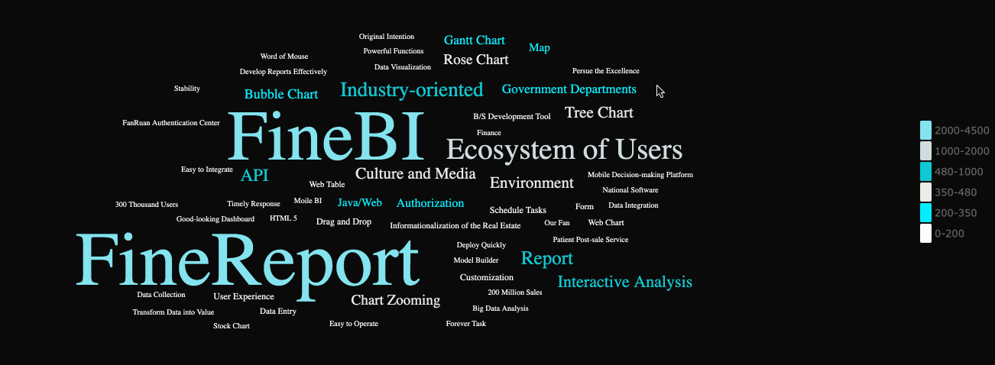
Word Cloud Chart
The word cloud is a visual representation of data in the form of text. It displays a colorful cloud-like graphic of lots of vocabulary words. These graphs are used to display large amounts of text form data and help users quickly highlight the most prominent text.
Usage example: keyword search

Slide 18
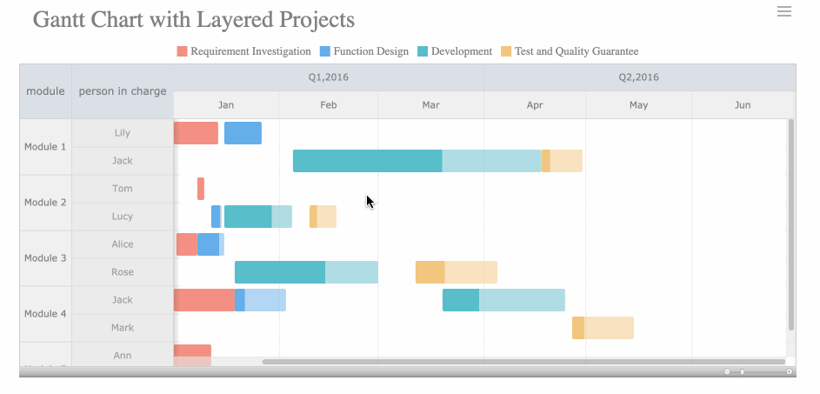
Gantt Chart
The Gantt chart displays the time of each stage visually, the actual progress and comparisons as needed. So, managers can easily understand the progress of a project.
Usage examples: project progress, status changes over time, project process

Slide 19
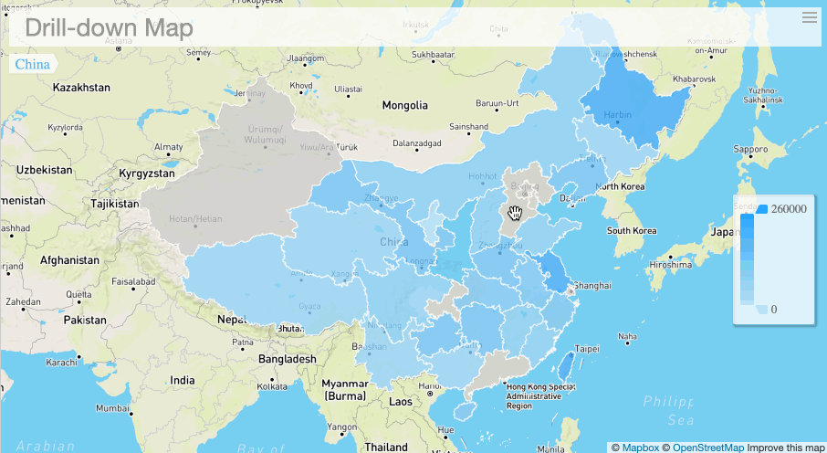
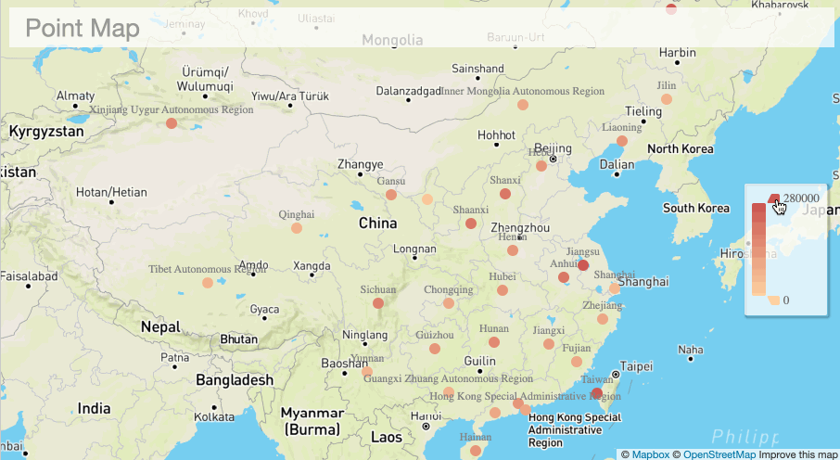
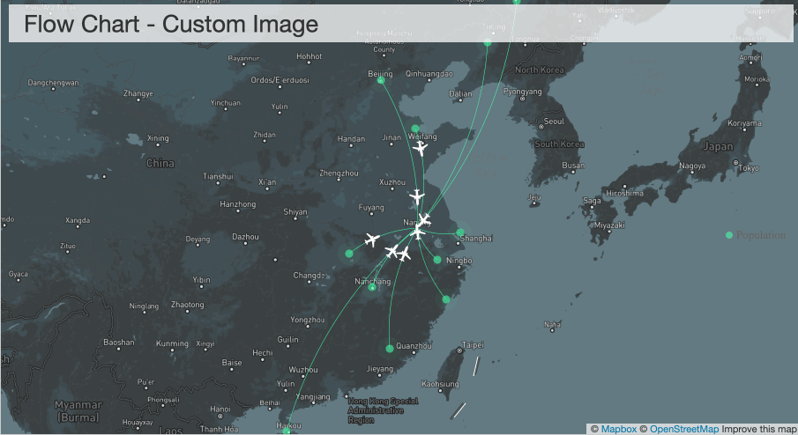
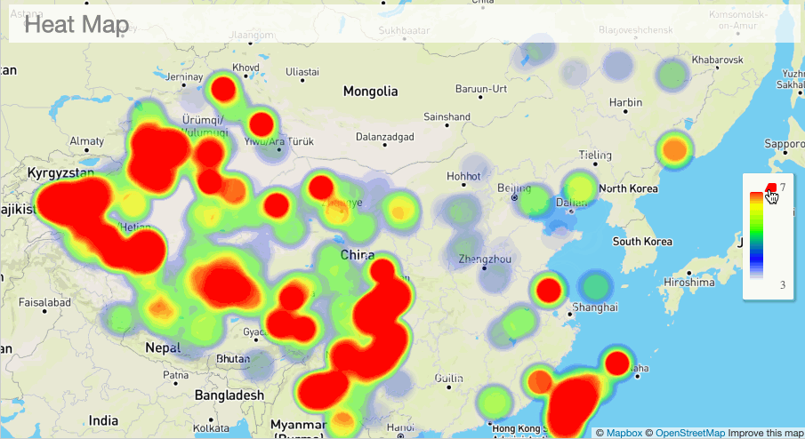
A R E A M A P
P O I N T M A P
M A P S
F L O W M A P
H E A T M A P

Slide 20
Area Map
A regional map is a map that uses colors to represent the distribution of a range of values on the map.
Usage examples: data comparison and distribution

Slide 21
Point Map
A point map is a method of displaying the geographical distribution of data by placing equally sized points on a geographical background.
Usage example: data distribution
If you replace the dots with bubbles, then the point map can not only show the distribution but also roughly compare the size of the data in each area.

Slide 22
Flow Map
A flow map is a type of thematic map that uses linear symbols to represent movement.
Usage examples: data flow, distribution and comparison

Slide 23
Heat Map
Heat map is used to show the weight of each point in a geographical area. Besides the map used as the background, you can also use other images. Colors in a heat map usually indicate density.
Usage examples: regional visits, heat distribution, distribution of various things

Slide 24
BUSI
NESS
TEMP
LATE
THANKS
BUSI
NESS
TEMP
LATE

